Slide 1
Adaptation to Climate Change: Challenges for Farmers and Small Towns in the US Midwest
Eugene S. Takle
Professor
Department of Agronomy
Department of Geological and Atmospheric Science
Director, Climate Science Program
Iowa State University
Ames, IA 50011
House Environmental Protection Committee
Iowa Legislature
Des Moines, IA
21 February 2012

Slide 2
Outline
What are we already adapting to?
Temperature
Precipitation
Humidity
Current agricultural adaptation practices
Adaptation challenges for rural communities
Using recent climate records to establish a world view for visioning climate futures

Slide 3
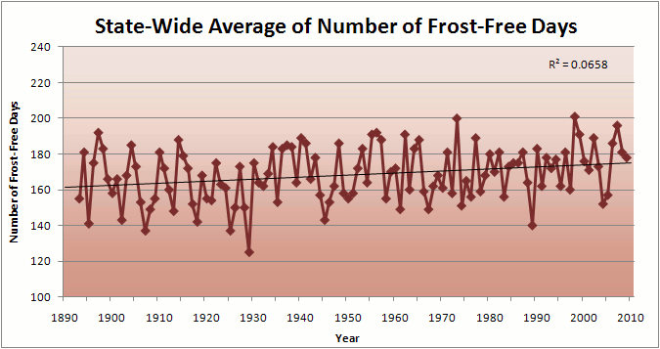
Iowa State-Wide Average Data

Slide 4
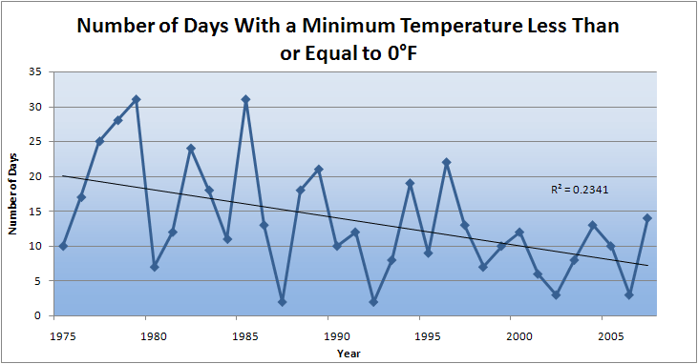
Des Moines Airport Data
Caution: Not corrected for urban heat island effects

Slide 5
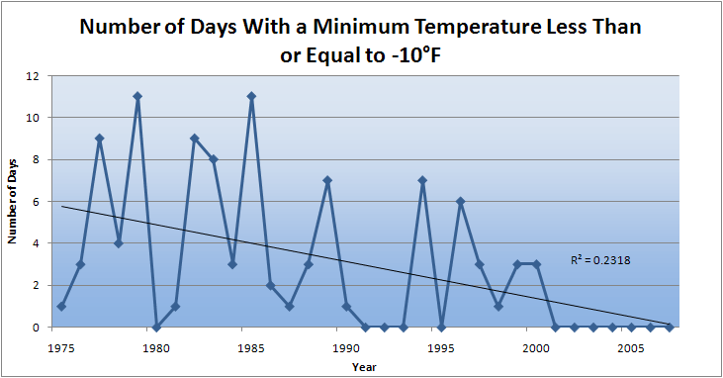
Des Moines Airport Data
Caution: Not corrected for urban heat island effects

Slide 6
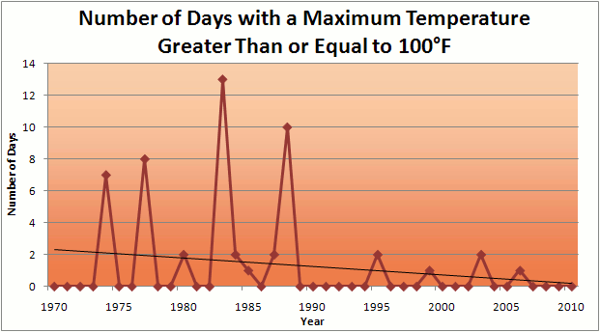
Des Moines Airport Data
1983: 13
1988: 10
1977: 8
1974: 7
2011: 0

Slide 7
Des Moines Airport Data
1983: 13
1988: 10
1977: 8
1974: 7
6 days ≥ 100ºF in the last 23 years
2011: 0

Slide 8
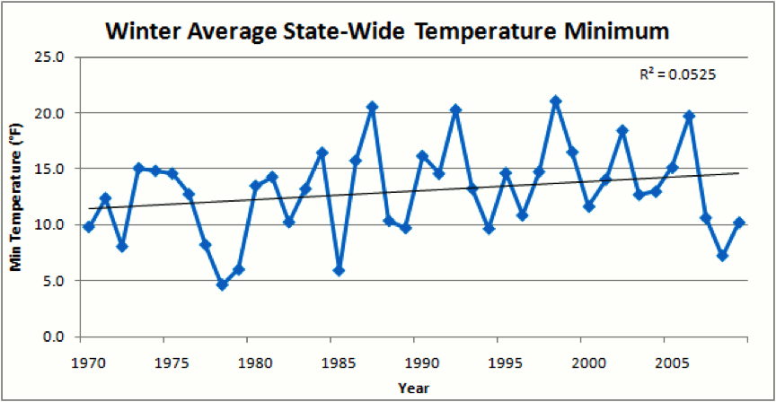
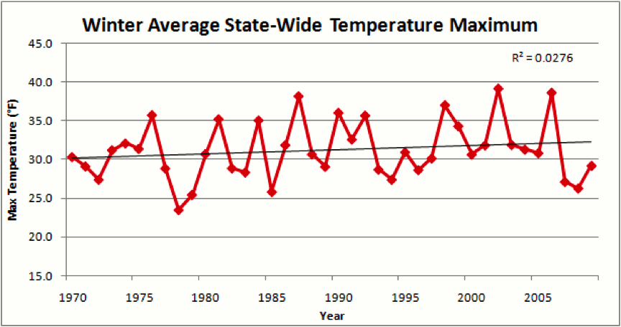
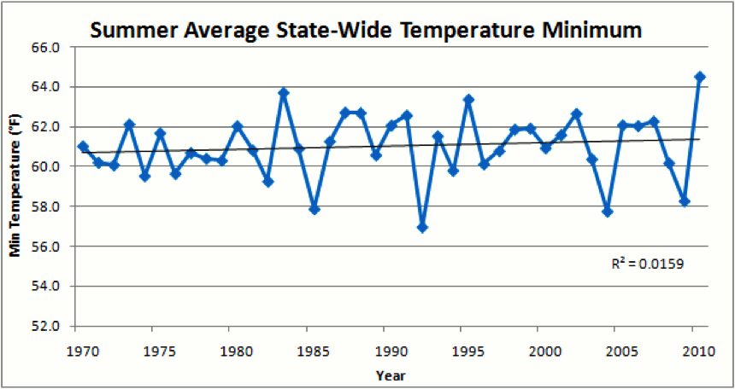
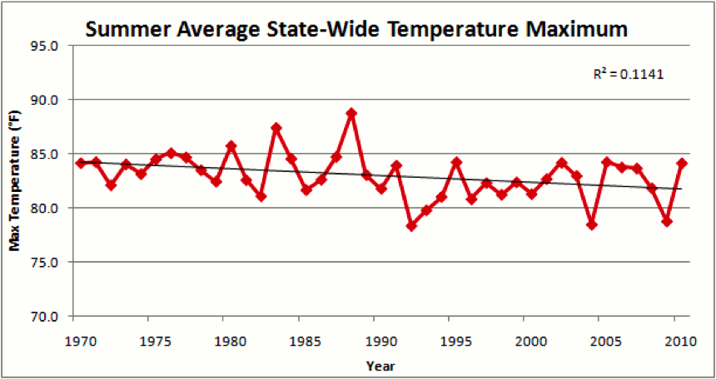

Slide 10
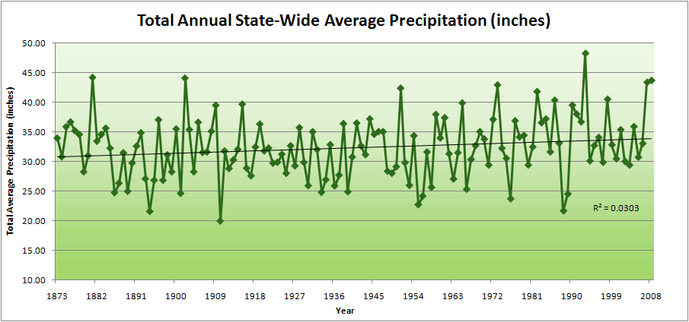
Iowa State-Wide Average Data

Slide 11
Iowa State-Wide Average Data
34.0”
10% increase
30.8”

Slide 12
Iowa State-Wide Average Data
Totals above 40”
2 years
34.0”
10% increase
30.8”

Slide 13
Iowa State-Wide Average Data
Totals above 40”
2 years
8 years
34.0”
10% increase
30.8”

Slide 14
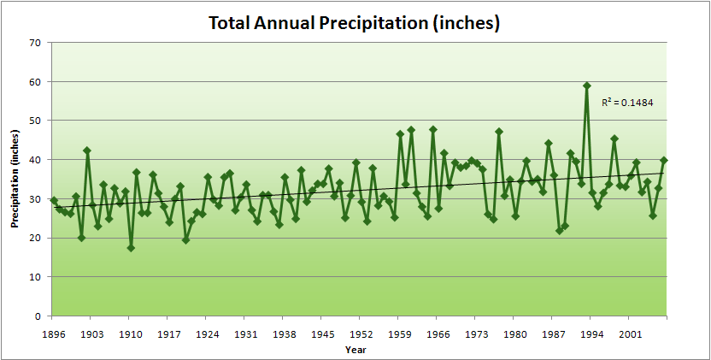
Cedar Rapids Data

Slide 15
Cedar Rapids Data
28.0”
32% increase
37.0”

Slide 16
Cedar Rapids Data
Years with more than 40 inches
11
1
28.0”
32% increase
37.0”

Slide 17
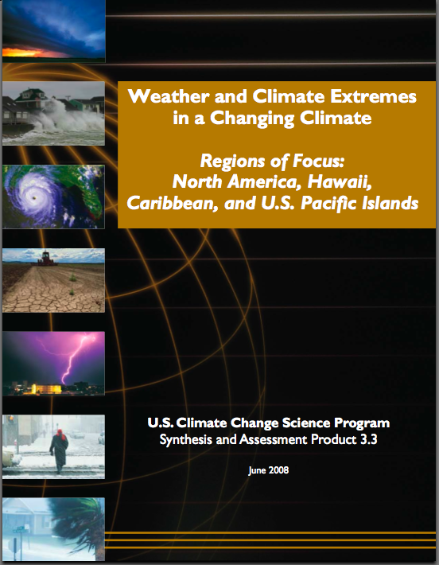
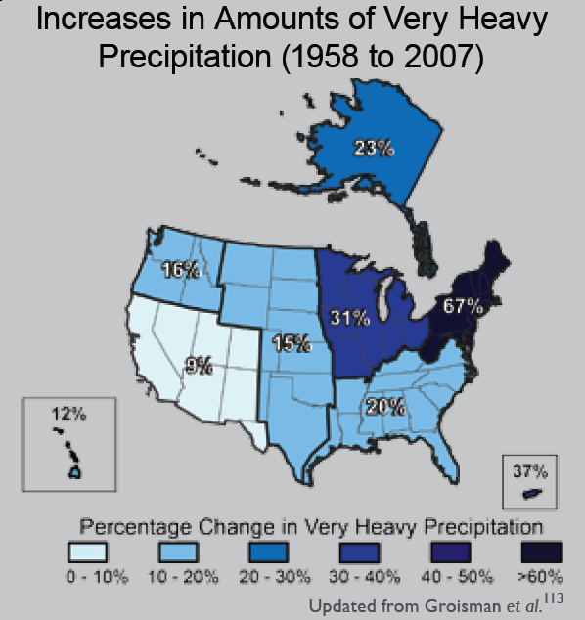
“One of the clearest trends in the United States observational record is an increasing frequency and intensity of heavy precipitation events… Over the last century there was a 50% increase in the frequency of days with precipitation over 101.6 mm (four inches) in the upper midwestern U.S.; this trend is statistically significant “
Karl, T. R., J. M. Melillo, and T. C. Peterson, (eds.), 2009: Global Climate Change Impacts in the United States. Cambridge University Press, 2009, 196pp.

Slide 18
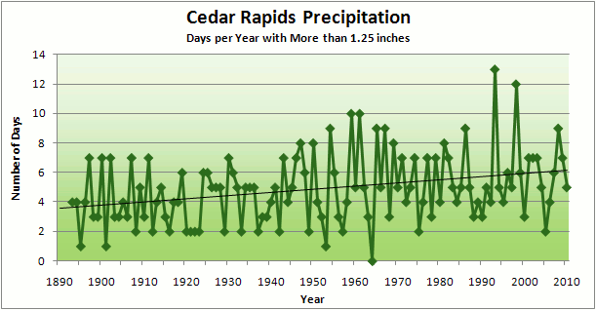
Cedar Rapids Data
3.6 days
67% increase
6.0 days

Slide 19
Cedar Rapids Data
Number of Years with More than 8 Occurrences
0
9
3.6 days
67% increase
6.0 days

Slide 20
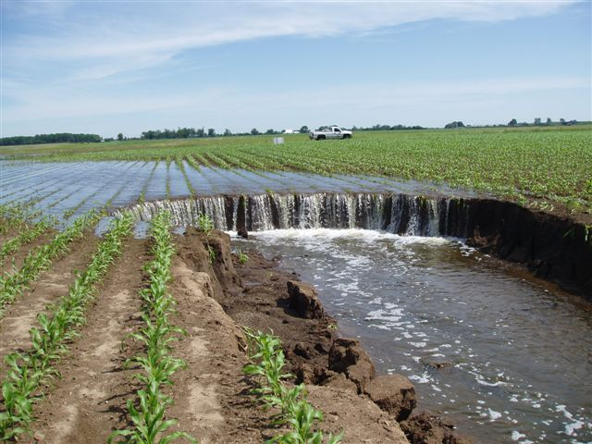
Photo courtesy of RM Cruse

Slide 21
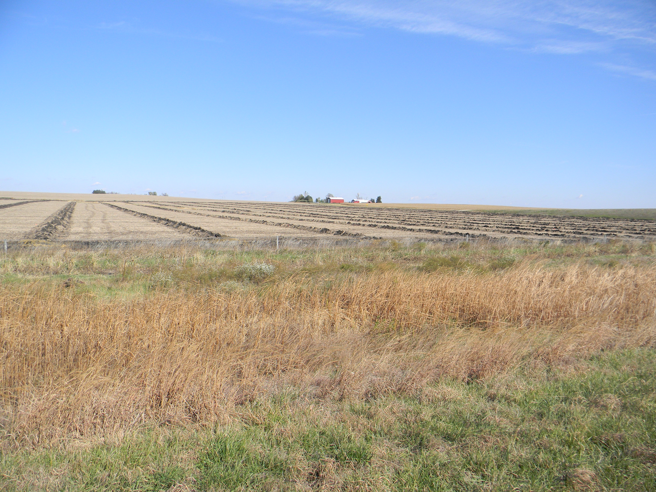

Slide 23
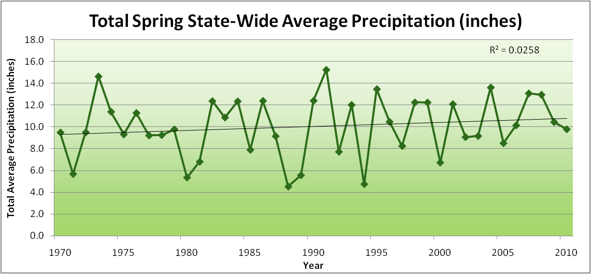
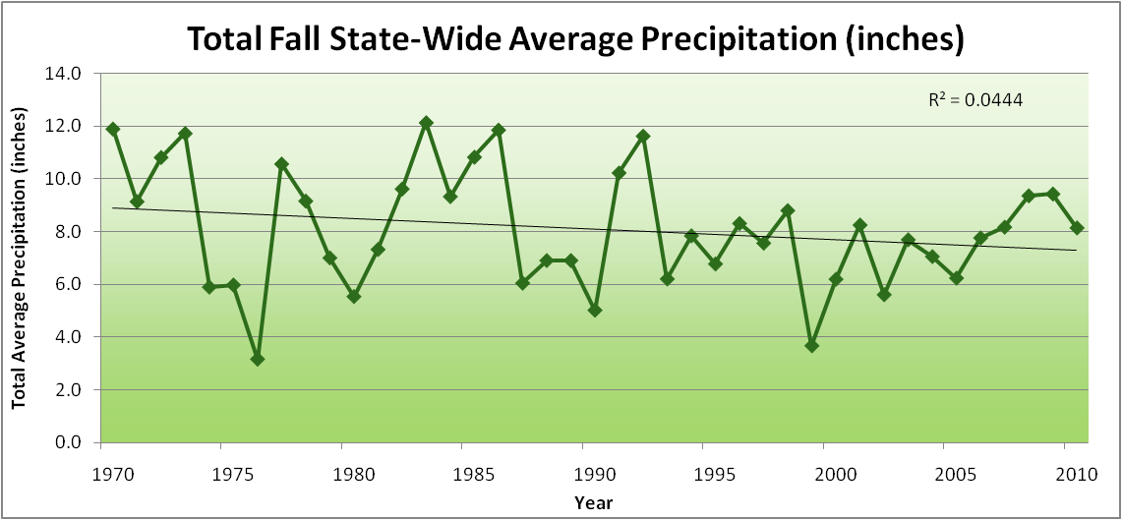
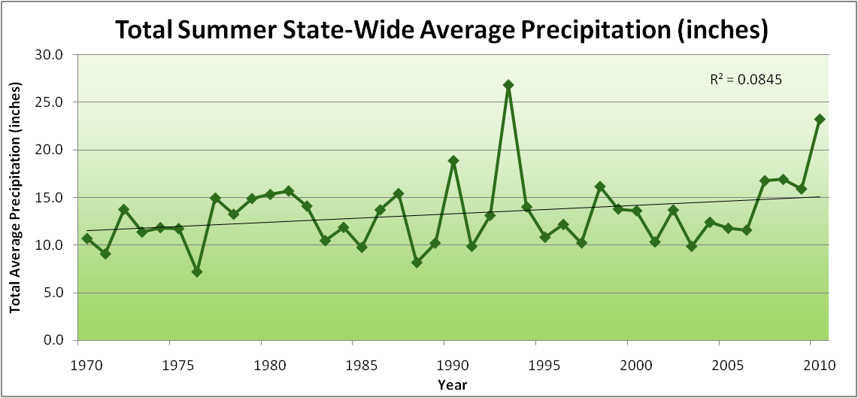
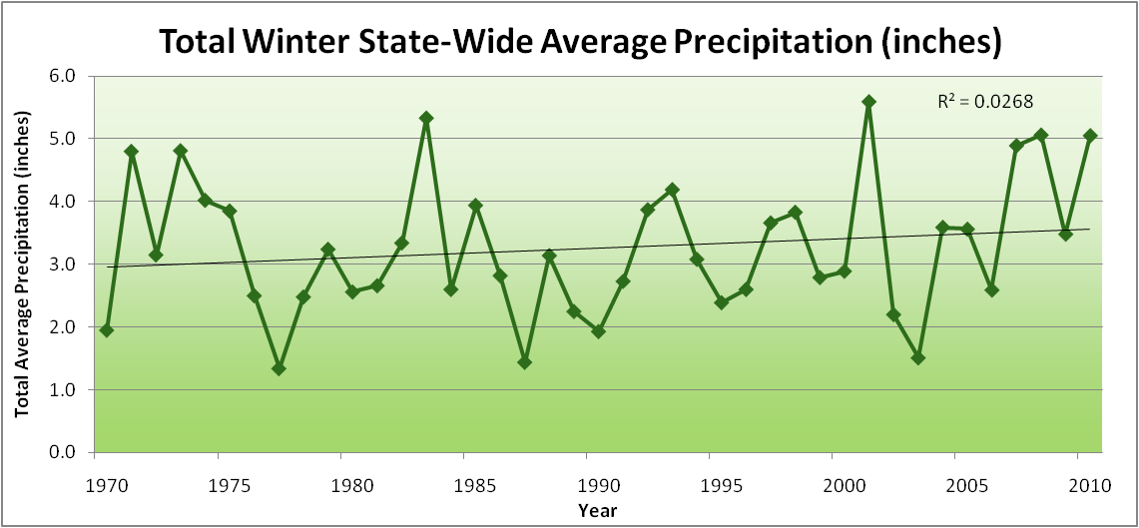
Amplification of the Seasonality of Precipitation
Spring
Fall
Summer
Winter

Slide 24
Amplification of the Seasonality of Precipitation
Spring
Fall
Summer
Winter

Slide 25
Amplification of the Seasonality of Precipitation
Spring
Fall
21.2 => 25.3 inches (22% increase)
12.1 => 10.5 inches (13% decrease)
Summer
Winter

Slide 26
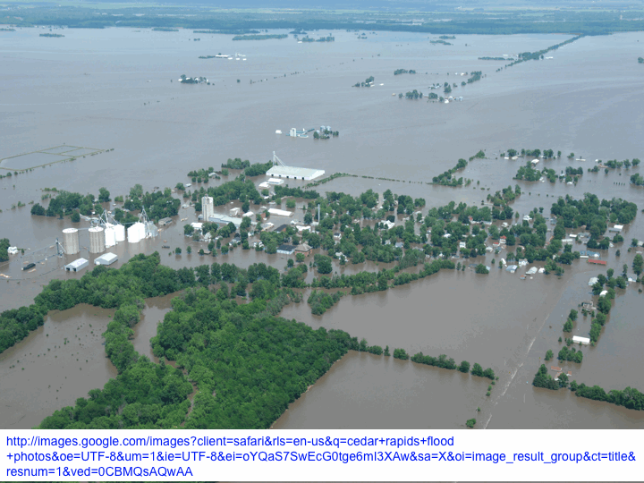

Slide 27
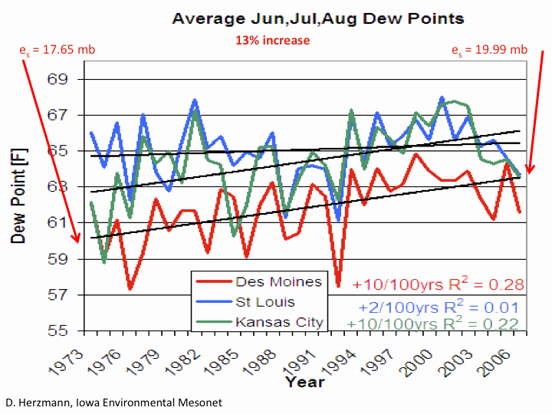

Slide 28
Iowa Agricultural Producers are Adapting to Climate Change:
Longer growing season: plant earlier, plant longer season hybrids, harvest later
Wetter springs: larger machinery enables planting in smaller weather windows
More summer precipitation: higher planting densities for higher yields
Wetter springs and summers: more subsurface drainage tile is being installed, closer spacing, sloped surfaces
Fewer extreme heat events: higher planting densities, fewer pollination failures
Higher humidity: more spraying for pathogens favored by moist conditions. more problems with fall crop dry-down, wider bean heads for faster harvest due to shorter harvest period during the daytime.
Drier autumns: delay harvest to take advantage of natural dry-down conditions, thereby reducing fuel costs
HIGHER YIELDS!!
Is it genetics or climate? Likely some of each.

Slide 29
Visioning a Future Climate of the Midwest

Slide 30
Visioning a Future Climate of the Midwest
You are here

Slide 31
Visioning a Future Climate of the Midwest
You are here
Today

Slide 32
Visioning a Future Climate of the Midwest
You are here
Today
Past

Slide 33
Visioning a Future Climate of the Midwest
You are here
Today
Past
Future

Slide 34
Visioning a Future Climate of the Midwest
You are here
?
Today
Past
Future

Slide 35
You be the scientist: For which hypothesis of the future can you find the most evidence?
?
Some Climate Variable (temp, precip, humid)
Today
Past
Future

Slide 36
You be the scientist: For which hypothesis of the future can you find the most evidence?
Some Climate Variable (temp, precip, humid)
Measured past
Today
Past
Future

Slide 37
You be the scientist: For which hypothesis of the future can you find the most evidence?
Some Climate Variable (temp, precip, humid)
Measured past
Future will return to something in the past
Today
Past
Future

Slide 38
You be the scientist: For which hypothesis of the future can you find the most evidence?
Future will be like average of the past
Some Climate Variable (temp, precip, humid)
Measured past
Future will return to something in the past
Today
Past
Future

Slide 39
You be the scientist: For which hypothesis of the future can you find the most evidence?
Future will be like today
Future will be like average of the past
Some Climate Variable (temp, precip, humid)
Measured past
Future will return to something in the past
Today
Past
Future

Slide 40
You be the scientist: For which hypothesis of the future can you find the most evidence?
Current trend will continue
Future will be like today
Future will be like average of the past
Some Climate Variable (temp, precip, humid)
Measured past
Future will return to something in the past
Today
Past
Future

Slide 41
You be the scientist: For which hypothesis of the future can you find the most evidence?
What does the best available science have to say?
Current trend will continue
Future will be like today
Future will be like average of the past
Some Climate Variable (temp, precip, humid)
Measured past
Future will return to something in the past
Today
Past
Future

Slide 42
You be the scientist: For which hypothesis of the future can you find the most evidence?
Based on climate models, climate scientists overwhelmingly agree that the future will be more extreme than today
Current trend will continue
Future will be like today
Future will be like average of the past
Some Climate Variable (temp, precip, humid)
Measured past
Future will return to something in the past
Today
Past
Future

Slide 43
Best Available Science
Future will be more extreme than today
Current trend will continue
Future will be like today
Future will be like average of the past
Some Climate Variable (temp, precip, humid)
Measured past
Future will return to something in the past
Today
Past
Future

Slide 44
Best Available Science
Volcanoes are the only known natural cooling mechanism of the last 100 years that can offset the known
global temperature increases due to
greenhouse gases
Future will be like average of the past
Some Climate Variable (temp, precip, humid)
Measured past
Today
Past
Future

Slide 45
Best Available Science
Offsetting current global temperature
increases due to greenhouse gases
by known natural causes will require
about 5 major volcanoes per decade.
By 2030 this rises to about 10/decade
Future will be like average of the past
Some Climate Variable (temp, precip, humid)
Measured past
Today
Past
2030

Slide 46
For More Information:
Climate Science Program
Iowa State University
http://climate.engineering.iastate.edu/
http://www.meteor.iastate.edu/faculty/takle/
gstakle@iastate.edu
Iowa Flood Center
University of Iowa
http://www.iowafloodcenter.org/
witold-krajewski@uiowa.edu

Slide 47
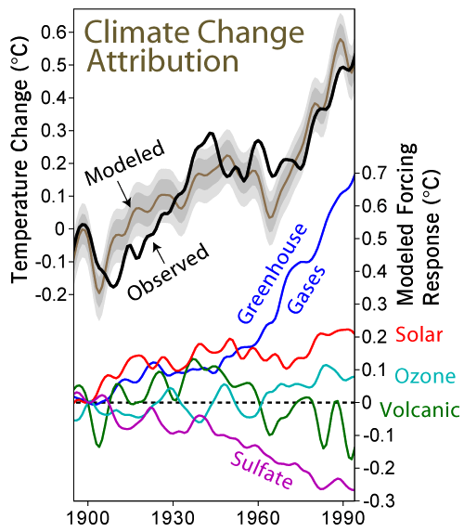
Cooling the Climate by Natural Processes
Currently it would take
about 5 major volcanoes
per decade to offset
GHG warming
Some Climate Variable (temp, precip, humid)
By 2030 it will take
about 10 major volcanoes
per decade to offset
GHG warming
Measured past
Past

